Slide 1
Secure Settings – Categorize Options
AVCDL-Implementation-3.1.2
Charles Wilson
Staff Product Cybersecurity Architect
version 2
2025-10-01
Notes:
Script:
I'm Charles Wilson, staff product cybersecurity architect at Torc Robotics.
This presentation will cover the Secure Settings – Categorize Options activity.

Slide 2
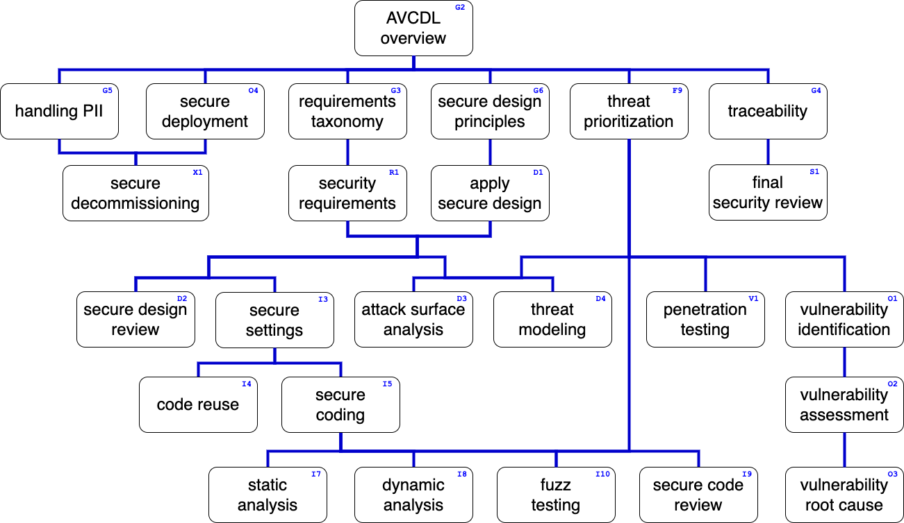
Training Path
Notes:
Script:
This diagram shows the overall AVCDL training path.
If you're taking this training, it's assumed that you've already completed the AVCDL Overview training,
and additionally, that you've completed the
Requirements Taxonomy
Security Requirements
Secure Design Principles
Apply Secure Design
Secure Settings Overview
and
Secure Settings – Identify Options
trainings.
This training will cover the Secure Settings – Option Categorization activity.

Slide 3
Introduction
Notes:
Script:
Before getting into option categorization, let's briefly review where it fits, in the overall secure settings process.

Slide 4
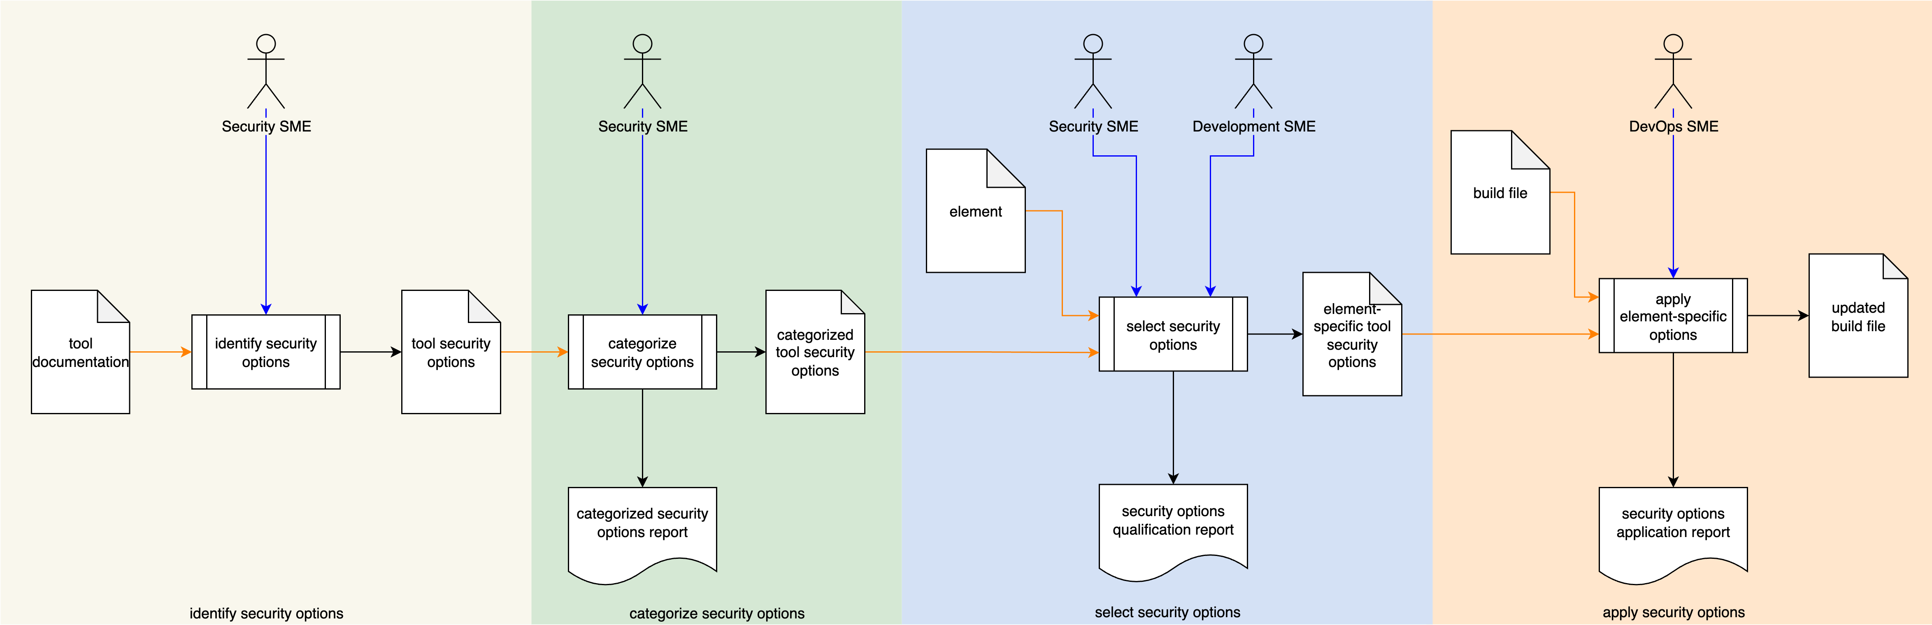
Secure Settings Process
Notes:
Script:
Here's the secure settings process which we previously covered in the Secure Settings Overview.
[break]
Our focus for this training is going to be on the second activity, that of option categorization.

Slide 5
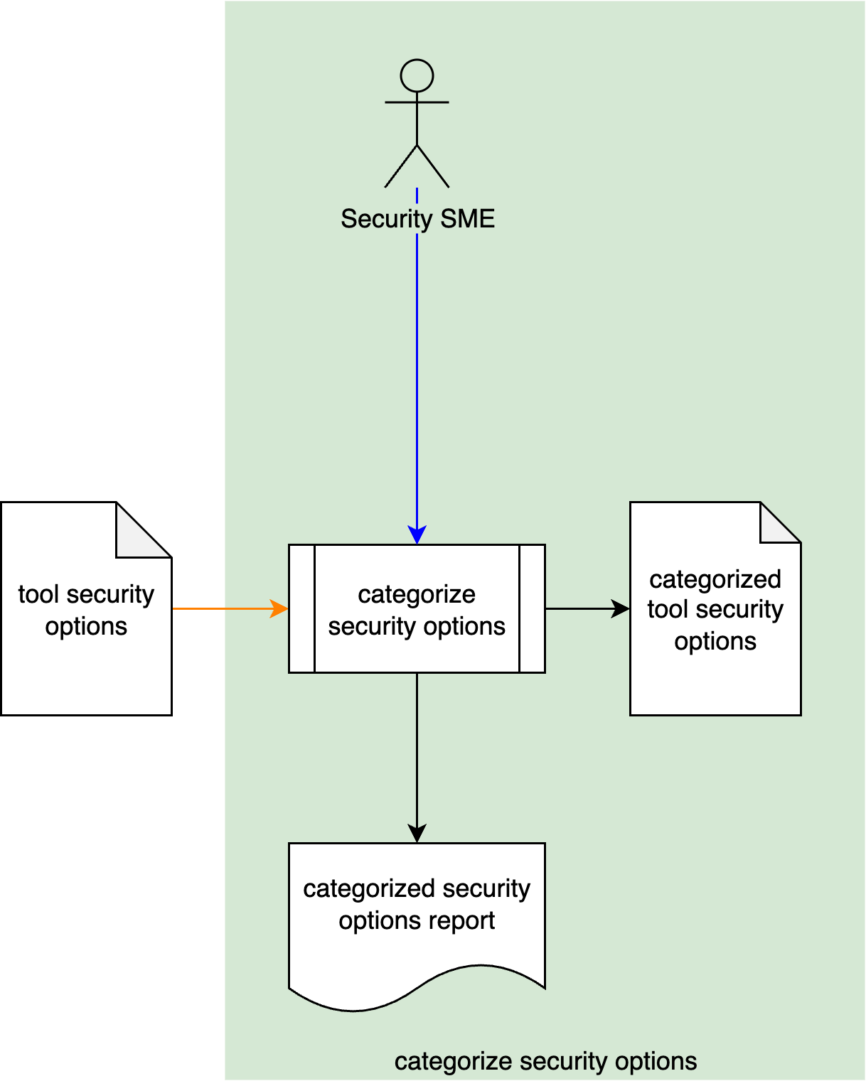
Secure Settings Process
Notes:
Script:
Here's the secure settings process which we previously covered in the Secure Settings Overview.
[break]
Our focus for this training is going to be on the second activity, that of option categorization.

Slide 6
Categorize Options Activity
Notes:
Script:
Within the categorize options activity,
The security SME
[pause]
takes
[pause]
the security options document created in the identify options activity,
[pause]
categorizes the identified security options,
[pause]
creates a categorized tool security options document
[pause]
and generates a categorized security options report.

Slide 7
Example
Notes:
Script:
Now let's work our way through an example of a tool’s cybersecurity-relevant option categorization.
We'll be working with the example tool cybersecurity options document created in option identification activity.
It's important to note here that this is just one mechanism for documenting this information.
There are any number of ways this information could be documented.
In an ideal world, you'd use a database to store this information both across tools and versions of tools.

Slide 8
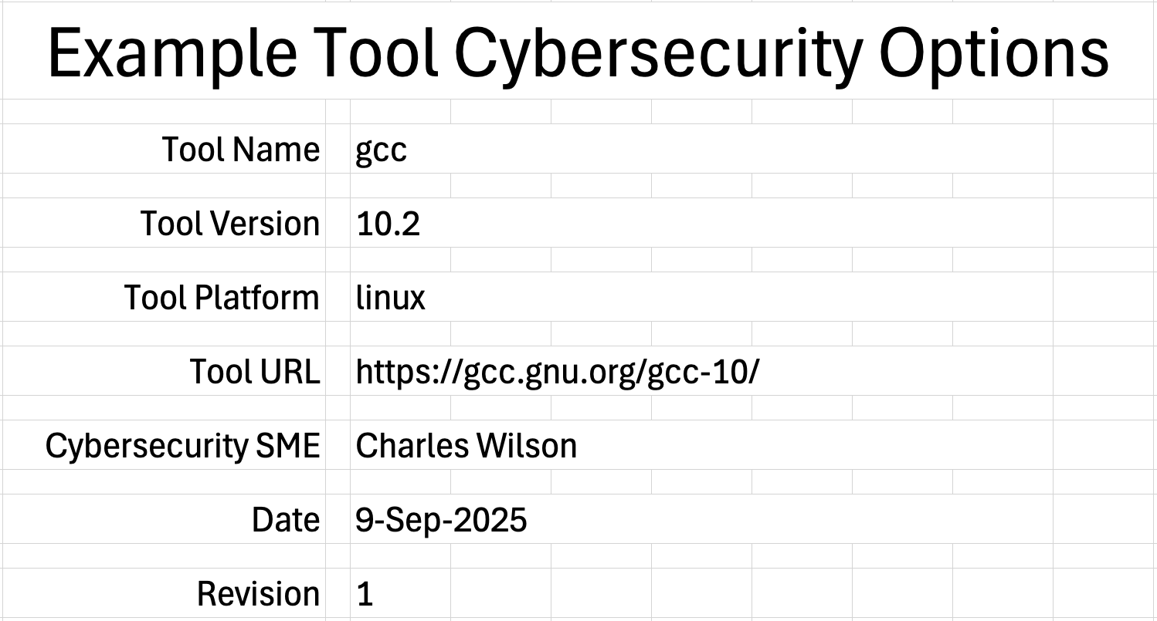
Cover Sheet
Notes:
Script:
We're going to start this exercise with a bit of administrivia.
Here's the cover sheet information that was created for the option identification activity.
Whenever you're modifying information that you've already collected,
[pause]
make sure that you update the revision number and the date.
And also make the corresponding updates to the revisions sheet.
This may seem trivial, but it's really important as you're tracking changes over time.

Slide 9
17-Sep-2025
2
Notes:
Script:
[overlay]

Slide 10
Severity Categories
Notes:
Script:
Before we assign the actual categories, we need to establish what they are.
Before we do that, let's review what we covered in the overview about severity categories.

Slide 11
Establishing Categories
Low
Medium
High
May Do
Must Do
Notes:
Script:
Let’s consider the diagram used in the overview training and talk about a moderate complexity categorization where we have low, medium, and high severity.
The options categorized as high severity, are done first, the medium ones are done next, and finally, the low ones, are done when you get around to it.
Practically speaking, this never happens.
In fact, this reality is only made worse by the realization that this step is establishing the categories used for all of the switches, not just for the subset of the identified switches as applied to individual elements, where we're going to trim the option set even further.
What you end up with is a management nightmare where you're trying to keep every option ranked and then include them in some arbitrary basis in a high-complexity space.
A far simpler and more practical way to handle this is to simply go with the two-bucket may do and must do.
When you create a categorization, you have to identify what its boundaries are, so that it’s clear what goes into each bucket.
The higher the granularity you use, the more rules that you need to have.
If you have a simple two-bucket system, this problem reduces to establishing a threshold.
You still go through the process when considering individual elements of establishing which settings to use because you need to have that documented, but once you’ve addressed the issues in the must do bucket, you can adjust the threshold to move options from the may do to the must do bucket.
This is a far simpler process than having to readjust the qualifications of multiple buckets.
And so, this is the recommended approach.

Slide 12
Categories
Notes:
Script:
With this in mind, Here are the categories used in the context of this example.
They're ID'd CAT-BOOL-01 and CAT-BOOL-02.
The reason for this is that the categories, the “may do,” and “must do” are fairly generic.
If we determine that, as shown here, the “must-do’s” are required, the “may do’s” are discretionary, so we may be able to use the qualifications across multiple tools.
If you find you can't use these across multiple tools, then your IDs will need to change, but if you can make them the same, that's a good thing.
Here, what we see is that CAT-BOOL-02, or “must do” is required.
The qualifications for that category are that it addresses all memory class bugs.
That's it.
One simple rule.
We're going to focus on memory bug classes, and as it shows in CAT-BOOL-01, the “may do,” which is discretionary is anything that's not “must do”.
You can have more sophisticated rules, say for instance, you just want to do two of the memory class bugs, or some other combination of things, that’s fine.
This is why there's the notes field, in case there needs to be additional elaboration as to what the qualifications are about.
As a reminder, if you have categories already established, then you can reuse them.

Slide 13
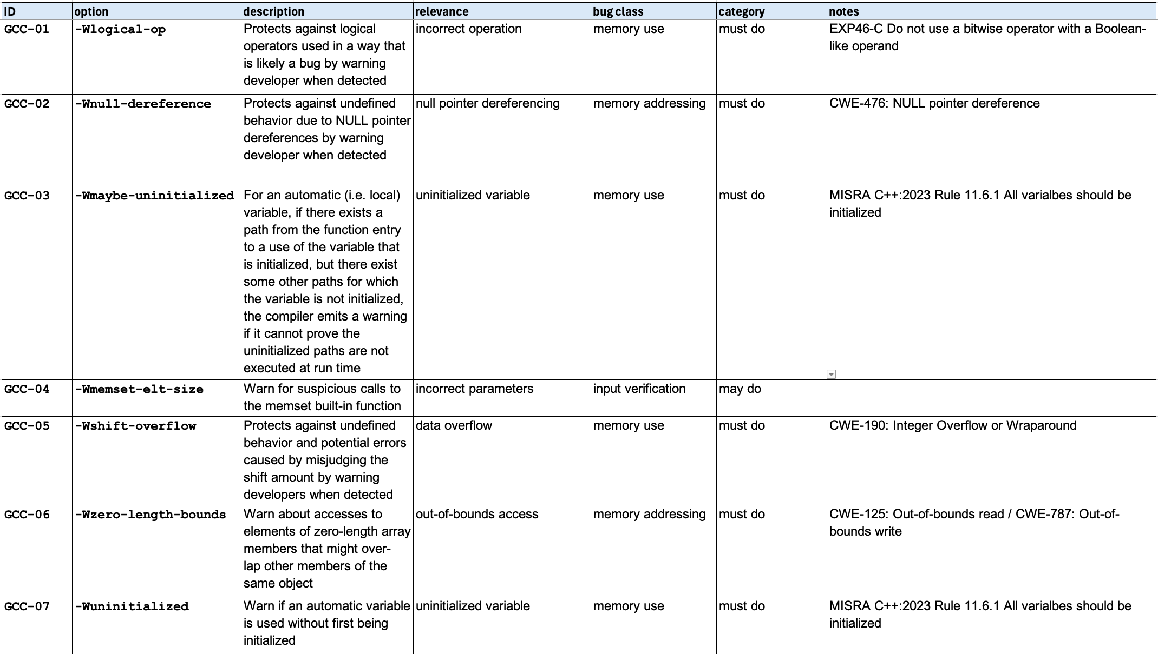
Options - Category
Notes:
Script:
With the categories in-hand, we now assign a category to each of the options that we've identified, as shown here.
As described, all of the memory bug classes have been set to “must do,” and our single input verification class item is set to “may do.”
And that's all that needs to be done in terms of creating that category assignment.

Slide 14
Report
Notes:
Script:
This brings us to the part of the activity that everyone looks forward to, and that is the generation of the human-readable report.
Let's consider some of the reasons why it's necessary to have a human-readable report, and not just a file that embodies the data.

Slide 15
Human-readable Report
Data extraction not required
PDFs are immutable
Auditors like PDFs
Notes:
Script:
There are a few reasons why we generate a human-readable report, in addition to the form that the data is stored in, either a spreadsheet as shown here, or in a database.
The first reason is that you don't have to extract the data from the data source in order to make sense of it.
In the case of Excel, you could say that this is just a standalone document and therefore, it's going to be in a change control system.
If you have a sophisticated enough system, then it makes far more sense to be using a database that allows you to track changes across systems rather than relying on just a collection of workbooks.
[pause]
The second reason is that we tend to instantiate these as PDFs and PDFs are, by and large immutable.
This is not always the case, but the way that we treat them, they're immutable.
We can put them into storage systems and attach them to the collection documents that go along with the product.
[pause]
This brings us into the third reason, and that's that auditors like PDFs.
They're directly readable, and don't generally rely on having additional applications to access them.
Additionally, they’re constructed in a way which is easily consumed by a person, as opposed to requiring sifting through spreadsheets in order to make sense of the data.
[pause]
For the CI/CD pipeline inclined, it is straightforward to programmatically generate a PDF from either an Excel workbook or a database.
You can create it with nice formats and have all of the lovely things that you would associate with a human-readable document and not lose the fact that it's tied to a single source of truth.
This also ensures a consistent presentation over time.

Slide 16
Recap
Notes:
Script:
That covers the secure settings option categorization activity.
Now let's summarize what we've done and talk about next steps.

Slide 17
Summary
Identify the severity categories
Define category qualifications
Provide justification where appropriate
Categorize the identified options
Create a human-readable report
May be reused
Notes:
Script:
So to review, our approach is as follows.
We're going to identify the severity categories,
[pause]
define the category qualifications and thresholds for each category,
[pause]
and provide a justification for each where it's appropriate.
It's important to note that we may be able to reuse this category set.
Next, we categorize each of the identified options.
Finally, we create the human-readable report that goes into the document management system.

Slide 18
Example Materials
<AVCDL>/source/reference_documents/working_material/secure settings/
Notes:
Script:
The materials that were used to cover this example are in the location shown here.
It's important to note that the updated workbook includes all the sheets covered in this training.

Slide 19
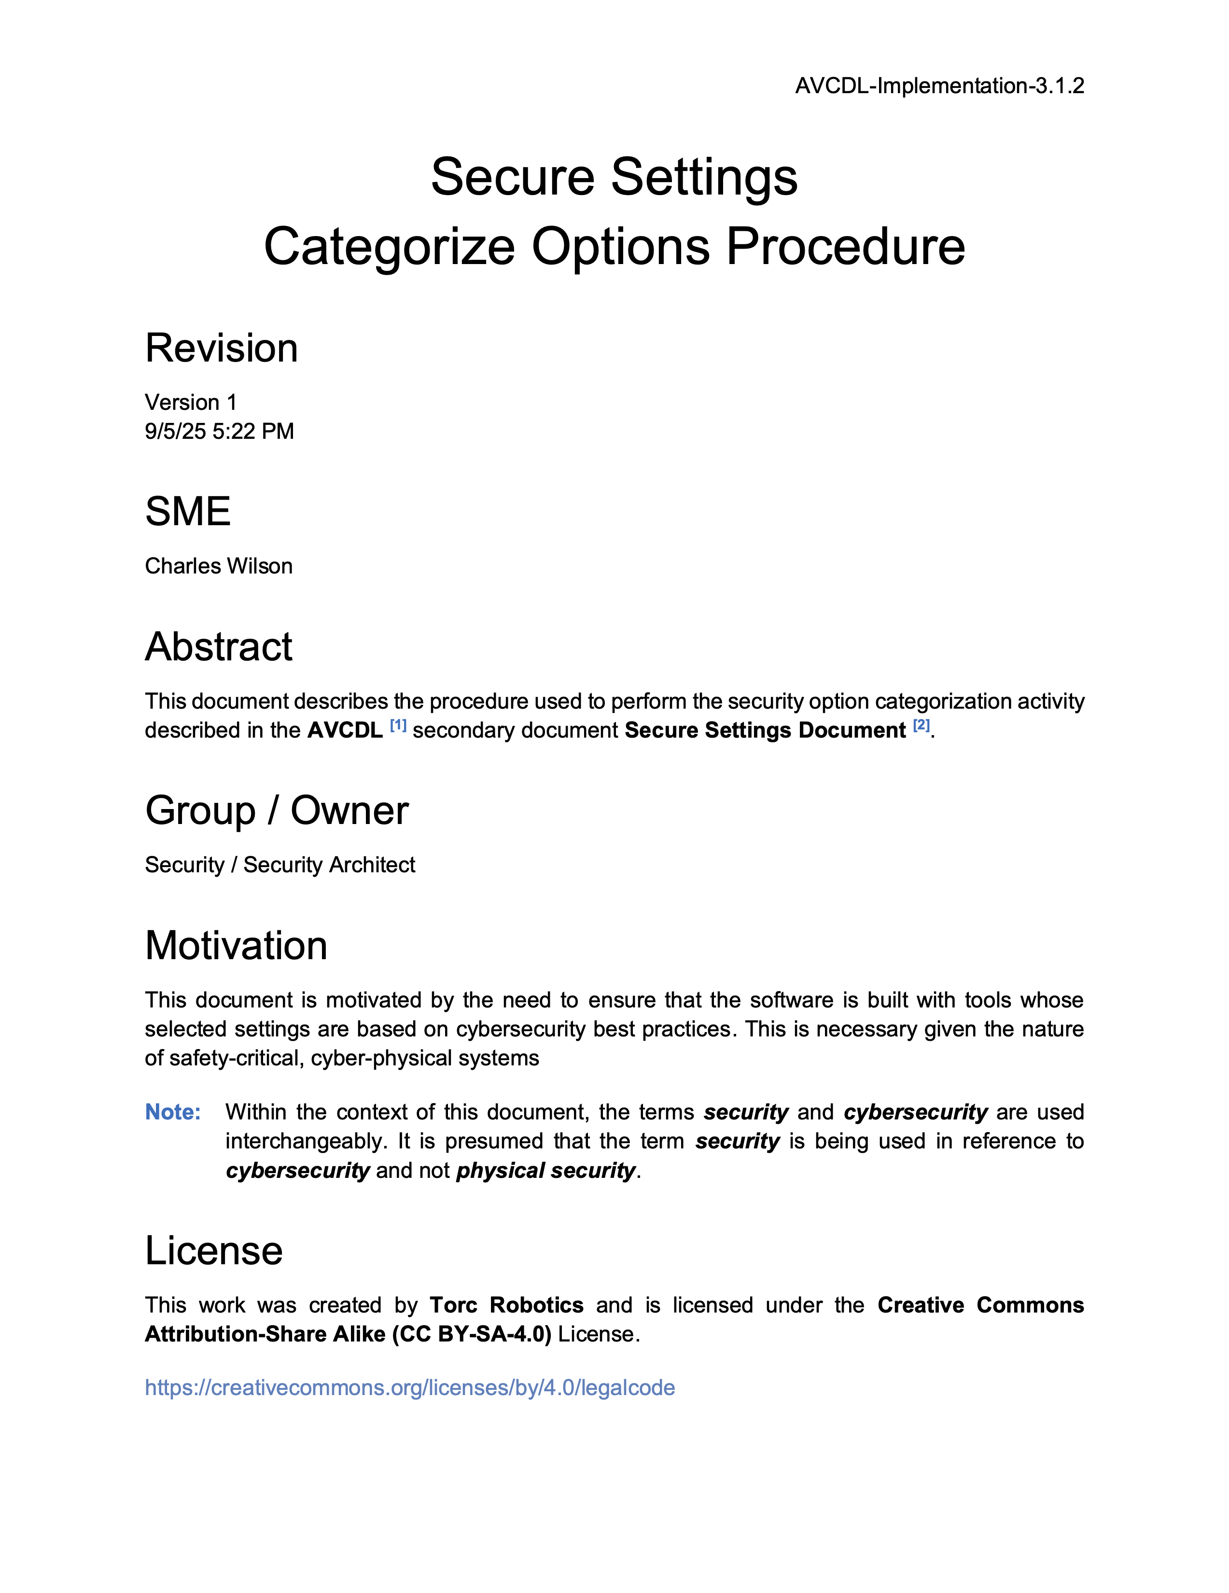
Further Reading
Notes:
Script:
For additional information and to get a more in-depth set of references, the Secure Settings – Categorize Options Procedure tertiary document is available in the AVCDL GitHub repository.

Slide 20
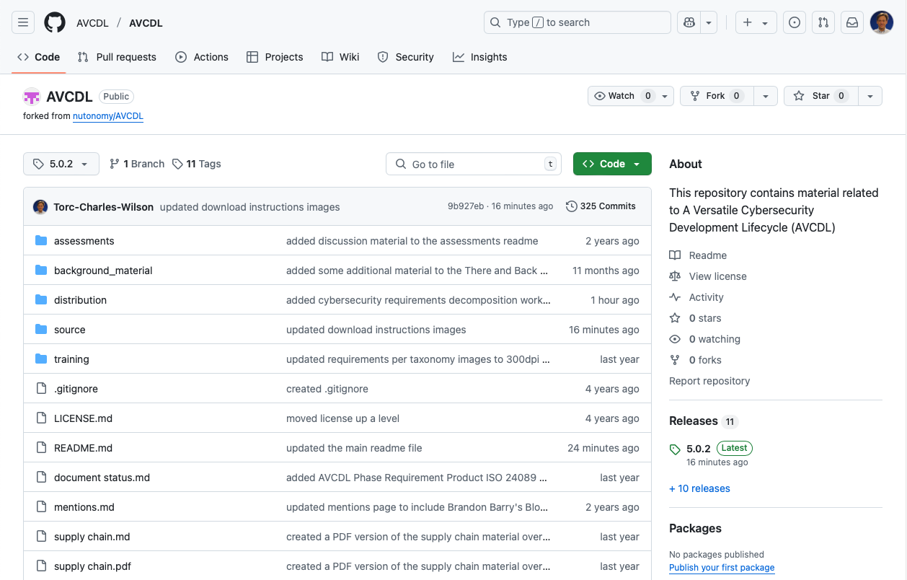
AVCDL on GitHub
https://github.com/AVCDL/AVCDL
Notes:
Script:
All AVCDL materials, both in source and distribution forms, are available on our GitHub site, as shown here.
Because of the size of the repository, it's recommended that you either clone the repository or download a ZIP archive of it, if you're not familiar with using git.
Instructions for downloading a ZIP archive are linked to on the repository’s front page.

Slide 21
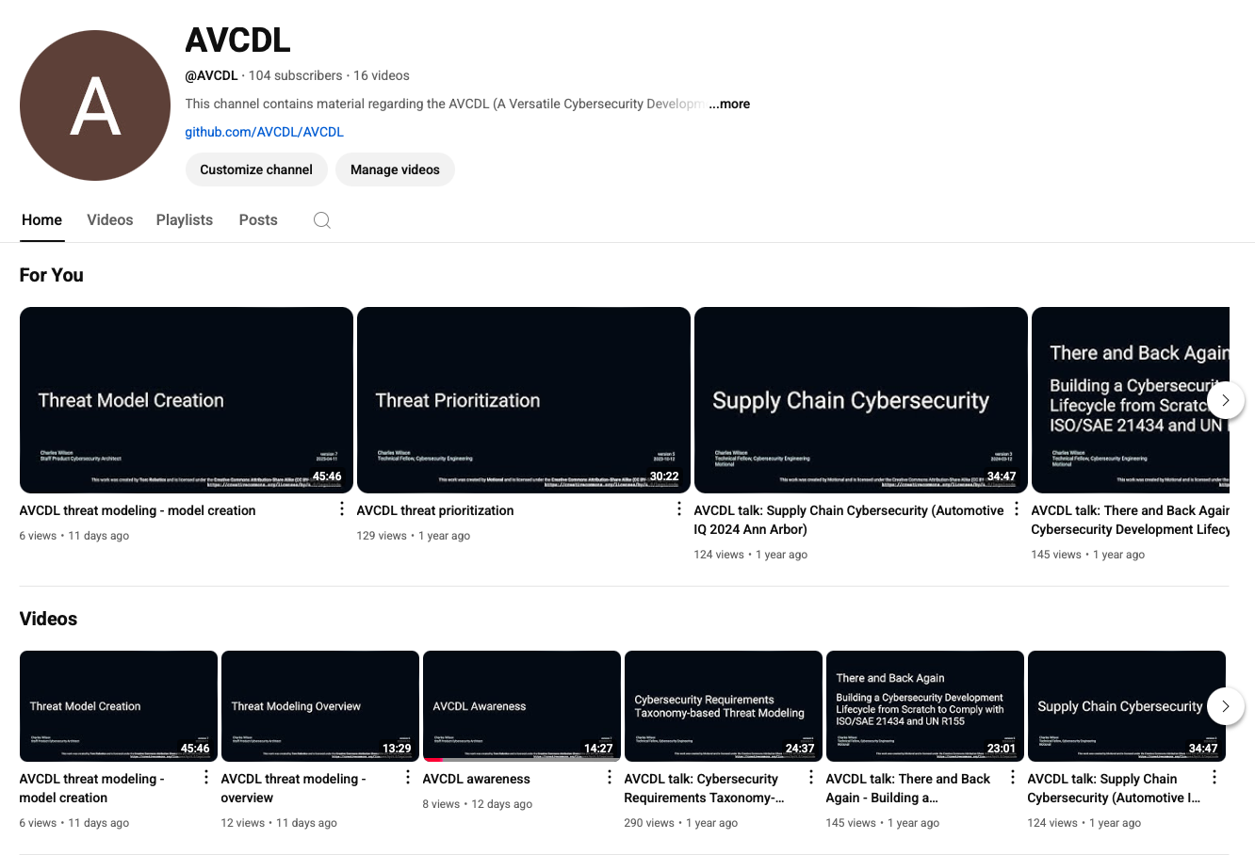
AVCDL on YouTube
https://youtube.com/@AVCDL
Notes:
Script:
Videos covering various aspects of the AVCDL are available on our YouTube channel, as shown here.
It's important to note that all AVCDL materials except for the introductory blog posts are intended for product cybersecurity engineering practitioners.

Slide 22
Next Steps
Notes:
Script:
With this training complete, if you’ve completed the other trainings covering the Secure Settings process activities, you can proceed to the other training at this level, Secure Design Review.
Additionally, if you’ve completed Threat Prioritization you can also proceed to
Attack Surface Analysis
Threat Modeling
Penetration Testing
and
Vulnerability Identification
Additionally, you can proceed to either
Code Reuse
or
Secure Coding

Slide 23
References
AVCDL primary document
Secure Settings Document (AVCDL secondary document)
Secure Settings – Identify Options Procedure (AVCDL tertiary document)
Secure Settings – Categorize Options Procedure (AVCDL tertiary document)
AVCDL tool cybersecurity options template (AVCDL template)
Notes:
Script:
Here are references to the source material used in the creation of this presentation.
They'll also be included in the video description.
Additionally, this presentation’s source material will be provided on the AVCDL GitHub repository.

